Slide 1
BASH II
11.15.24

Slide 2
Quick Recap of BASH commands (for ref.)
cd change directory
pwd print working dir.
echo print
mv move
cp copy
ls list contents
mkdir make directory
unset remove a value from array
cat read file(s) or combine. Write text
> write to file
>> append to file
rm remove
touch make file
$ expand variable
# comment or count
@ all
! array keys
#!/bin/bash “Shebang”
(set shell to BASH)

Slide 3
For-Loops (reminder)
val1 val2 val3
for var_name in VALUES
do
done
${val_array[@]}
{1..7}

Slide 4
Learning Objectives
Logic/conditionals
Piping
Text processing grep/sed

Slide 5
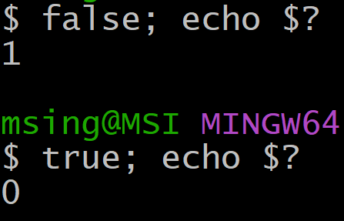
BASH Logic=Exit Status
0=true
1=false
BASH thinks about False as something failing, so it uses exit codes (fail=1)
= get last exit status

Slide 6
Evaluating Logicals
Logical statements are evaluated using either “test” or brackets
[[ var1 operator var2 ]] [[ ${name} == "spam" ]]
test var1 operator var2 test ${val} < 5
Brackets are preferred
examples
STRING operators
-z length zero? < or > less/greater than in alpha-order
-n nonempty?
== equality
!= not equal

Slide 7

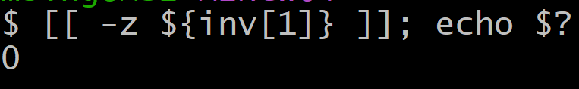

Evaluating Logicals
[[ var1 operator var2 ]]
Is second element empty? (True)
STRING operators
Does first element begin with q? (False)
-z length zero?
-n nonempty?
== equality
!= not equal

Slide 8
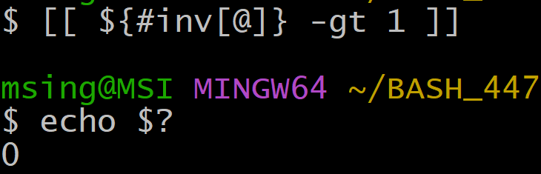
Evaluating Logicals
Because BASH is untyped, we use a different syntax to specify number-logic.
No =, <, > etc.
Is there more than one element? (True=0)
-eq equal
-lt less-than
-gt greater-than
-le less/equal
-ge greater/equal
#inv[@] counts the number of elements in inv

Slide 9
Conditional Blocks
if [[ condition ]]
then
fi
if [[ cond1 ]]
then
elif [[ cond2 ]]
then
else [[ cond3 ]]
fi

Slide 10
Example:
I want to find the folders and the empty-files in a directory
I’ll return the names of empty files (1 per line) and specify if it is a folder if it is a empty file
I’ll write this as a shell-script with one argument (the base directory)
Empty_File: abc.txt
Directory: spam
….

Slide 11
Some useful commands for this example
-f filename exists, is not a directory
-d filename exists, is a directory
-s filename exists, has size greater than zero
$(ls) The parentheses here capture the output of ls
--this is called a subshell
bDir=${1:-"."} This sets the default value of position- argument 1 as "." (i.e. cd) and stores as bDir

Slide 12
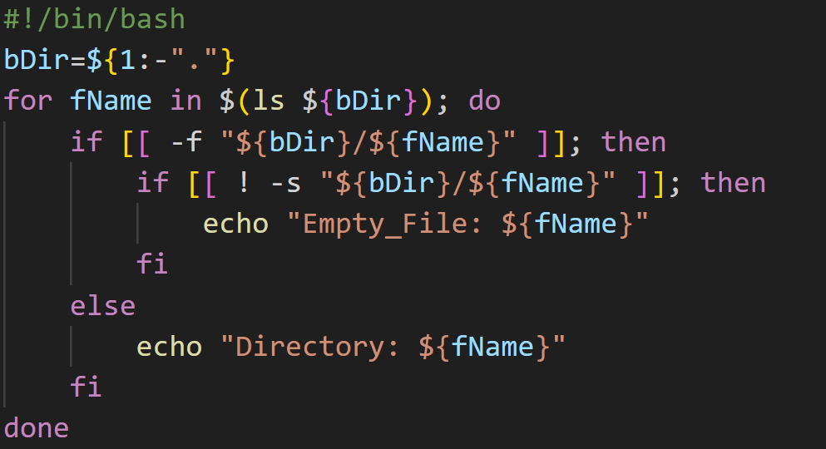

Slide 13

Pipelines
Pipelines take the output of one command and pass it to a new one
Format is:
comm1 | comm2 | comm3….
Only some commands allow pipes (but any script will)

Slide 14
Text Processing Pipeline Commands
wc word-count returned as lines words characters (3 outputs)
paste Joins text horizontally (takes multiple files) similar to cat
sort (-n = alphanumeric, -r = reverse, -u = remove duplicates)
uniq removes repeat lines (after sorting)

Slide 15
Example Pipelines
Get number of files/folders in a directory
ls|wc –l (-l means only return line-count)
Read a file, sort by order and remove duplicate lines
cat filename|sort –nu

Slide 16
Practice
Create two text files with some overlapping lines in a new folder
e.g.
mkdir bashTest;cd bashTest;
echo -e "foo\nbar">tmp1.txt;
echo -e "spam\nbar\nkale">tmp2.txt;
Write a pipeline that returns the number of unique items between all lists (one line)

Slide 17
xargs
Some commands need the incoming pipe to be converted to an argument using xargs
I want to create a directory based upon two text files:
foldersToMake.txt and filesToMake.txt
cat foldersToMake.txt|xargs mkdir -p;
cat foldersToMake.txt|xargs touch;

Slide 18
Pattern Matching
For directories
find identifies files/folders based on criteria
-name: find -name "*.txt" finds text files in cd
-mtime: find -mtime -7 find files modified within 7 days of today (+7 for older than 7 days)

Slide 19
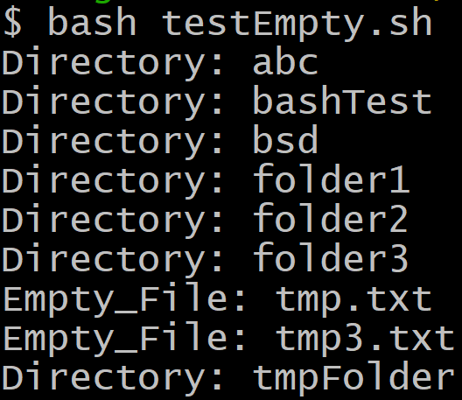
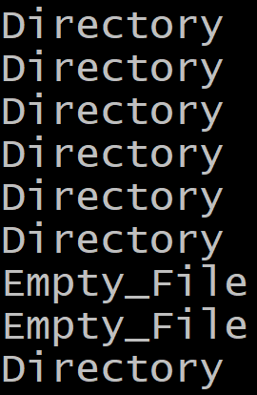
Cut
Split and return lines by delimiter (-f) or position (-c)
bash testEmpty.sh|cut -d ":" -f 1
Split based upon :
Give me the first “column”
(field) after splitting

Slide 20
grep = get regular expression
grep finds text lines matching a pattern
How many times does JFK appear in the flights_table.csv?
For # of lines use -c flag (or |wc –l pipe)
grep -c "JFK" flights_data.csv
I can also search recursively adding the -r flag and specifying a folder

Slide 21
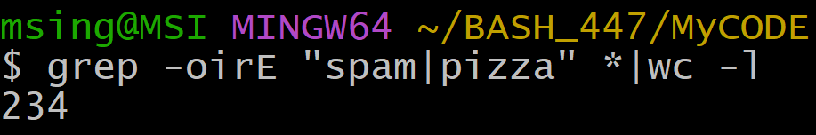
grep = get regular expression
-r flag lets you search recursively!!! (everything)
-E = extended regex for spam or pizza
How many times in this course have pizza or spam appeared in my code?

Slide 22
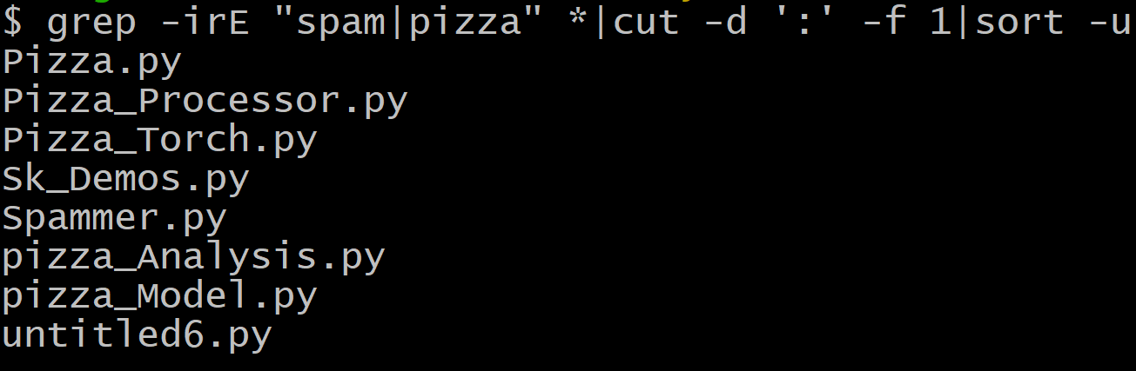
grep = get regular expression
Which files contained spam or pizza?
Report all matches from grep, cut at “:” and give left half (file-name) then remove duplicates

Slide 23
sed
Stream editor = find and replace
sed ‘s/pattern/replace’ filename
By default only first occurrence per line, add –g for every occurrence.

Slide 24
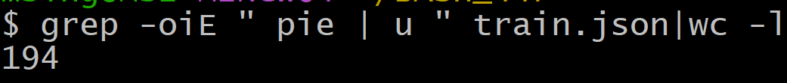
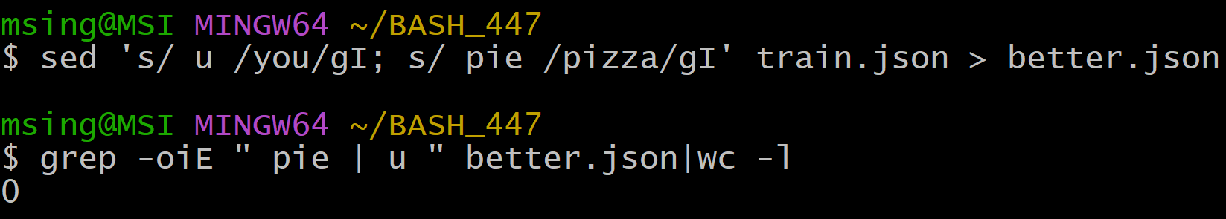
Let’s fix some pizza grammar
Replace pie with pizza
Replace “ u “ with you
I’m going to make u, pie case invariant +I flag

Slide 25
Learning Objectives
Logic/conditionals
Piping
Text processing grep/sed

